Slide 1

Green Pace
Security Policy Presentation
Developer: Daryl J. Miller

Slide 2
OVERVIEW
What will be covered:
Defense In Depth (DiD)
Threat Matrix
Security Principals
Coding Standards
Encryption Strategy
Triple-A Framework
Unit Testing
Automation Summary
Risk and Benefits
Recommendations

Slide 3

OVERVIEW: DEFENSE IN DEPTH
Defense In Depth (DiD)
Redundant Defense
Security Principals
Coding Standards
Encryption Standards
Triple-A Standards

Slide 4
THREATS MATRIX
Risk Assessment:
10 Standards
5 x High
2 x Medium
3 x Low
Likely Those most likely to occur | Priority Red P12-P18
Low priority Orange P6 | Unlikely Those least likely to occur

Slide 5
10 PRINCIPLES
Principal | Standard
1. Validate Input Data | STD 001, STD 004, STD 005, STD 006, STD 007, STD 008, STD 009, STD 010
2. Heed Compiler Warnings | STD 002, STD 003, STD 007
3. Architect and Design For Security | STD 001, STD 004, STD 005, STD 006, STD 007, STD 008, STD 009, STD 010
4. Keep It Simple | STD 001, STD 002, STD 003, STD 004, STD 005, STD 006, STD 007, STD 008, STD 009, STD 010
5. Default Deny | STD 004
6. Adhere to the Principal of Least Privilege | STD 004, STD 009, STD 010
7. Sanitize Data Sent to Other Systems | STD 003, STD 004
8. Practice Defense in Depth (DiD) | STD 004
9. Use Effective Quality Assurance (QA) Techniques | STD 001, STD 002, STD 003, STD 004, STD 005, STD 006, STD 007, STD 008, STD 009, STD 010
10. Adopt a Secure Coding Standard | STD 001, STD 002, STD 003, STD 004, STD 005, STD 006, STD 007, STD 008, STD 009, STD 010

Slide 6
CODING STANDARDS
Standard Number | Standard | Rule | Severity | Likelihood | Remediation Cost | Priority | Level
1 | Data Value | STD-001-CPP | High | Probable | Medium | P12 | L1
2 | Data Type | STD-002-CPP | Low | Unlikely | Low | P3 | L3
3 | String Correctness | STD-003-CPP | High | Likely | Medium | P18 | L1
4 | SQL Injection | STD-004-CPP | High | Probable | Medium | P12 | L1
5 | Memory Protection | STD-005-CPP | High | Likely | Medium | P18 | L1
6 | Assertions | STD-006-CPP | Low | Unlikely | High | P1 | L3
7 | Exceptions | STD-007-CPP | Low | Probable | Medium | P4 | L3
8 | Concurrency | STD-008-CPP | Medium | Probable | High | P4 | L3
9 | Containers | STD-009-CPP | High | Probable | High | P6 | L2
10 | Integers | STD-010-CPP | Medium | Unlikely | Medium | P4 | L3

Slide 7
ENCRYPTION POLICIES
3 x Encryption Policies:
Encryption in Rest – Fully encrypted data on a disk
This will prevent unauthorized access should the disk be accessed by someone
Encryption at flight – Fully encrypting data as its being sent from one location to another
Useful for drives that may store data in an unencrypted form. Data will be encrypted while at flight
Encryption in use – Fully encrypt and decrypt the data based on user privileges.
Useful when applying the standard of least privilege so someone cannot access the memory to get the decryption key

Slide 8
TRIPLE-A POLICIES
There are 3 policies that make up Triple-A Policies:
Authentication – Authenticating a user based on login credentials
Authorization – Authorizing a user and allowing access to only the systems governed by their access
Accounting – Accounting for the user’s actions and logging the information

Slide 9
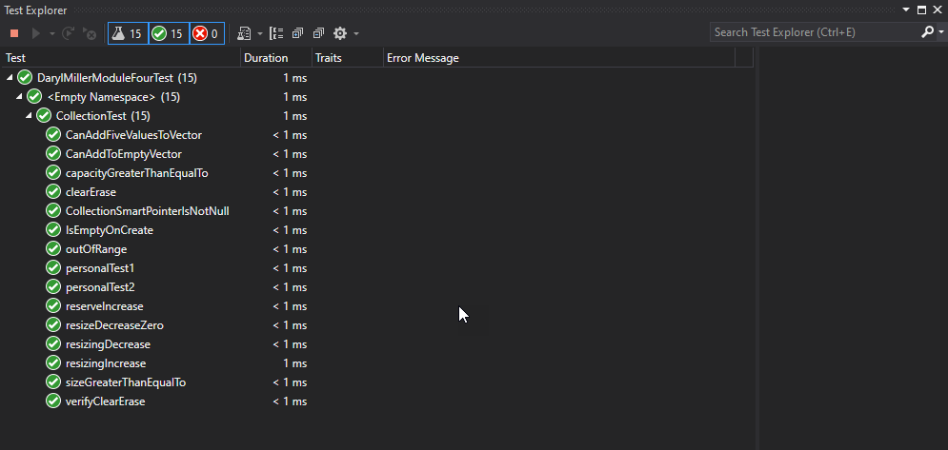
Unit Tests
Unit Tests are useful to test a variety of vulnerabilities

Slide 10
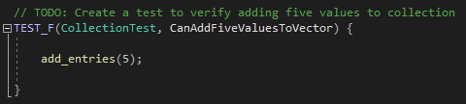
Adding Value Unit Test
This Unit Test will verify adding five values

Slide 11
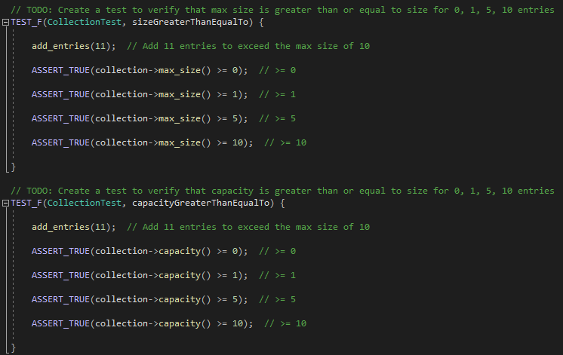
Verifying Max Size and Capacity Unit Test
This Unit Test will verify that a max collection size is greater than or equal to a given number.
This Unit Test will verify the capacity is greater than or equal to a given number

Slide 12
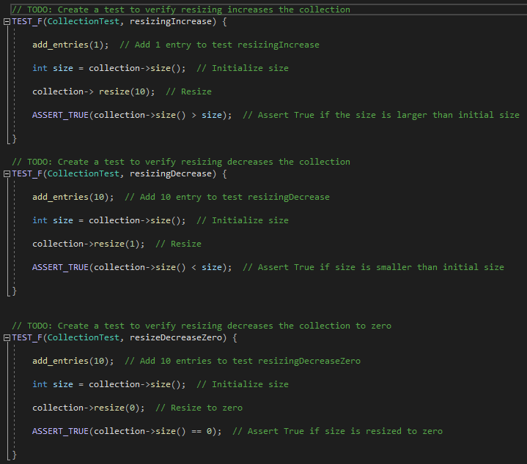
Resizing Unit Test
This Unit Test will verify that resizing the collection size also increases or decreases the collection size
This Unit Test will verify resizing the collection size to zero

Slide 13
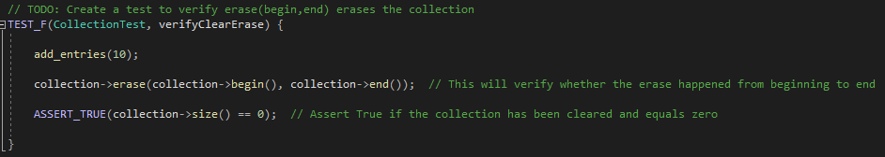
Erase beginning to end Unit Test
This Unit Test will verify whether the erase happened from beginning to end and assert true if the collection has been erased and set to zero

Slide 14

AUTOMATION SUMMARY

Slide 15
TOOLS
DevSecOps – The process of automating the integration of security at every phase of the software development lifecycle (SDLC), from initial design through integration, testing, deployment, and software delivery
Tools:
Codacy
SonarQube
Acunetix
Logz.io
GitLab
Contrast Security
Aqua Security
XebiaLabs
WhiteSource

Slide 16
RISKS AND BENEFITS
Risk – The main risks are cost, manpower, and reputation
Identifying and eliminating bugs early in the planning stage is the most beneficial
6 x more costly if found and fixed during implementation
15 x more costly if found and fixed during QA
Samsung Note 7 example - $17 billion to fix battery management system in Production

Slide 17
RECOMMENDATIONS
Gaps:
Identify gaps as soon as possible
Monitor for known and unknown threats
Have a plan to react to and mitigate threats
Recommendations:
Adhere to the set standards and principals as described
Implement and adhere to a strong DiD model
Utilize a robust Encryption Process and follow the Triple-A Policies

Slide 18
CONCLUSIONS
Learn and understand the coding standards and policies
Utilize a redundant DiD system and rely heavily on tools and automation
Continue to monitor the industry as applicable to your program and implement new standards and policies as needed to maintain a safe environment

Slide 19
REFERENCES
9 best devsecops tools to secure your application. WhiteSource. (2021, July 29). Retrieved December 6, 2021, from https://www.whitesourcesoftware.com/resources/blog/devsecops-tools/.
By: IBM Cloud Education. (n.d.). What is DevSecOps? IBM. Retrieved December 6, 2021, from https://www.ibm.com/cloud/learn/devsecops#toc-benefits-o-xSQ5W2ma.
Cost to fix bugs and defects during each phase of the SDLC: Synopsys. Software Integrity Blog. (2021, October 21). Retrieved December 6, 2021, from https://www.synopsys.com/blogs/software-security/cost-to-fix-bugs-during-each-sdlc-phase/.

